Slide 1
MAR ATHANASIUS COLLEGE OF ENGINEERING, KOTHAMANGALAM
MCA MINI PROJECT | INTERIM PRESENTATION
Medical Specialty Classification Using NLP and Ensemble Machine Learning
Phase 2: Model Training, Ensemble Evaluation & Empirical Findings
PRESENTED BY
Jiphin George
Register No: MAC25MCA-2033
Course: Master of Computer Applications (MCA)
Semester: 3 | Academic Year: 2026-2027
PROJECT GUIDE
Prof. Biju Skaria
Department of Computer Applications
Mar Athanasius College of Engineering, Kothamangalam
Affiliated to APJ Abdul Kalam Technological University
Clinical NLP
TF-IDF (8k Features)
4 Base Classifiers
Soft Voting Ensemble
Milestone: 30-09-2026

Slide 2
MCA MINI PROJECT | RECAP & OBJECTIVES
Project Recap & Phase 2 Objectives
Phase 1: Exploration & The 40-Class Baseline
• Exploratory Foundation (Phase 1): Analyzed Kaggle MTSamples clinical transcriptions (4,999 raw records) and built text cleaning, tokenization, and stop-word filtering routines.
• The 40-Class Baseline Barrier: Initial candidate model training across all 40 raw categories yielded poor accuracy, ranging between 7.85% and 27.39%.
• Root Causes of Baseline Collapse: 1. Extreme Class Skew: 1,103 Surgery records vs 2 Autopsy records.
2. Document Format Artifacts: SOAP notes, consults, and discharge summaries masquerading as specialties.
3. High Dimensionality: Over 310,000 unconstrained TF-IDF n-grams diluting clinical signal.
Phase 2: Refinement, Training & Evaluation
✓ Curate Mutually Exclusive Specialties: Refine the dataset to 8 core clinical specialties (1,663 records) eliminating procedural overlap and administrative formats.
✓ Constrain TF-IDF Representation: Fit an 8,000-feature unigram/bigram vectorizer strictly on training data with sublinear term-frequency scaling and L2 normalization.
✓ Train 4 Core Supervised ML Models: Train and tune Linear SVM, Logistic Regression, Random Forest, and Multinomial Naive Bayes using balanced class weighting.
✓ Ensemble Probability Calibration: Calibrate SVM via Platt scaling and formulate Hard Voting and Weighted Soft Voting (weights: LR=2, SVM=2, RF=1, MNB=1).
✓ Target Benchmark: Exceed the required 75.0% target accuracy threshold with robust macro/weighted F1-scores on 333 held-out test records.
Department of Computer Applications | MACE
Mar Athanasius College of Engineering, Kothamangalam
Slide 2 of 16

Slide 3
MCA MINI PROJECT | DATASET CURATION
Dataset Refinement & Clinical Specialty Selection
1. Cleaned Dataset (MTSamples)
• 4,966 Cleaned Records:
Filtered from 4,999 after removing 33 empty transcription records.
• 40 Original Categories:
Encompassed entire range of dictation types in hospital archives.
• Massive Majority Class:
Surgery contained 1,103 records (22.2% of the entire corpus).
• Target Whitespace Sanitization:
Leading/trailing whitespace in category strings stripped to ensure clean categorical indexing.
2. Structural Data Issues
⚠ Severe Class Imbalance:
Majority classes had 1,000+ records while small classes had <10 samples (Autopsy: 2, Lab Medicine: 8).
⚠ Administrative Document Types:
Non-specialty document formats:
• Consult - H&P: 516 records
• SOAP / Progress Notes: 166 records
• Discharge Summary: 108 records
• Emergency Room Reports: 75 records
• Office Notes: 50 records
⚠ Procedural Overlap:
Surgery acted as an umbrella category spanning cardiac, orthopedic, and abdominal procedures, causing severe cross-class confusion.
3. Curated Clinical Dataset
1,663 records across 8 core organ-system specialties with distinct clinical vocabularies:
✓ Cardiovascular / Pulmonary: 371 records
✓ Orthopedic: 355 records
✓ Gastroenterology: 224 records
✓ Neurology: 223 records
✓ Urology: 156 records
✓ Obstetrics / Gynecology: 155 records
✓ ENT (Otolaryngology): 96 records
✓ Ophthalmology: 83 records
Department of Computer Applications | MACE
Mar Athanasius College of Engineering, Kothamangalam
Slide 3 of 16

Slide 4
MCA MINI PROJECT | FEATURE EXTRACTION
Clinical Text Preprocessing & TF-IDF Vectorization
Clinical NLP Preprocessing Pipeline
• Narrative Text Enrichment: Concatenated clinical 'description' (summary abstract) with 'transcription' (full narrative) to capture comprehensive diagnostic vocabulary.
• Lowercasing & Cleaning: Standardized all text to lowercase; stripped punctuation, non-ASCII formatting noise, and special escape characters.
• Alphanumeric Filtering: Preserved alphanumeric clinical tokens (e.g., anatomical sites, dosage markers, surgical instruments).
• Medical Stop-Word Removal: Removed general English stop-words and non-informative clinical filler tokens while protecting diagnostic terminology.
• Morphological Lemmatization: Reduced inflected medical terms to base morphological root forms using WordNetLemmatizer, consolidating singular/plural variants.
TF-IDF Vectorizer Configuration
✓ max_features = 8000: Constrained vocabulary to the top 8,000 most discriminative tokens, preventing the curse of dimensionality and memory exhaustion.
✓ ngram_range = (1, 2): Extracted both unigrams (single terms like 'cataract', 'stent') and bigrams (phrase compounds like 'coronary artery', 'lumbar spine').
✓ sublinear_tf = True: Replaced raw TF with (1 + log(TF)) scaling to dampen the influence of overly repetitive clinical tokens.
✓ min_df = 2, max_df = 0.7: Pruned singleton words occurring < 2 times and filtered ubiquitous terms occurring in > 70% of documents.
✓ norm = 'l2' (L2 Normalization): Normalized all vector lengths to unit hypersphere, making representation invariant to report length variation.
✓ Strict Anti-Leakage Fitting: Vectorizer fit strictly on training set (1,330 samples); test set (333 samples) only transformed.
Department of Computer Applications | MACE
Mar Athanasius College of Engineering, Kothamangalam
Slide 4 of 16

Slide 5
MCA MINI PROJECT | MODEL PLANNING
Stratified Train-Test Dataset Partitioning (80:20 Split)
Stratified Split Class Distribution (80:20 Ratio)
Stratified Sampling Rationale
• Proportional Preservation: Guarantees that each of the 8 specialties has exactly 80% representation in training and 20% in testing, avoiding artificial sample starvation in minority classes like Ophthalmology.
• 333 Held-Out Test Records: Evaluation is conducted on a strictly quarantined 20% partition (333 records) never exposed to TF-IDF vocabulary construction or model fitting.
• Class Imbalance Shield: Without stratification, random partitioning would produce high variance in rare classes. Stratification ensures true real-world diagnostic balance.
• Fixed Random State (seed=42): Ensures complete reproducibility of splits across candidate models and ensemble benchmarks.
Medical Specialty Class | Total | Train (80%) | Test (20%)
Cardiovascular / Pulmonary | 371 | 297 | 74
Orthopedic | 355 | 284 | 71
Gastroenterology | 224 | 179 | 45
Neurology | 223 | 178 | 45
Urology | 156 | 125 | 31
Obstetrics / Gynecology | 155 | 124 | 31
ENT (Otolaryngology) | 96 | 77 | 19
Ophthalmology | 83 | 66 | 17
Total Curated Dataset | 1,663 | 1,330 | 333
Department of Computer Applications | MACE
Mar Athanasius College of Engineering, Kothamangalam
Slide 5 of 16

Slide 6
MCA MINI PROJECT | MODEL TRAINING
Four Candidate Machine Learning Classifiers
Support Vector Machine (LinearSVC)
Config: C = 1.0, class_weight = 'balanced', max_iter = 3000
• Mathematical Principle: Maximum-margin separation hyperplane in 8,000-dimensional sparse feature space.
• Advantage: Highly resilient to overfitting in high-dimensional text; finds optimal linear decision boundaries.
• Imbalance Handling: Automatically adjusts penalty inversely proportional to class frequencies.
Logistic Regression (Multinomial)
Config: Multinomial Softmax, class_weight = 'balanced', max_iter = 1000
• Mathematical Principle: Multinomial cross-entropy with L2 regularization penalty.
• Advantage: Highly calibrated probability estimation with direct interpretability of clinical token odds.
• Imbalance Handling: 'balanced' class weights compensate for majority dominance in gradient updates.
Random Forest Classifier
Config: n_estimators = 100, max_depth = 25, class_weight = 'balanced'
• Mathematical Principle: Bagging ensemble of 100 decorrelated decision trees with random feature subsampling.
• Advantage: Captures complex non-linear keyword interactions and hierarchy.
• Imbalance Handling: Class-weighted Gini impurity criterion guides split selections.
Multinomial Naive Bayes (MNB)
Config: alpha = 0.5 (Additive Laplace Smoothing)
• Mathematical Principle: Conditional word-frequency likelihood estimation via Bayes' Theorem.
• Advantage: Extremely fast training and low memory footprint; established text classification baseline.
• Smoothing: alpha=0.5 prevents zero-frequency zero probability traps for unseen diagnostic terms.
Note: Handled class imbalance natively using class_weight='balanced' cost-function penalization across LR, SVM, and RF.
Department of Computer Applications | MACE
Mar Athanasius College of Engineering, Kothamangalam
Slide 6 of 16

Slide 7
MCA MINI PROJECT | ENSEMBLE ARCHITECTURE
Hard & Weighted Soft Voting Architecture
Probability Calibration: Platt Scaling
• The Non-Probabilistic SVM Challenge: LinearSVC optimizes a margin hyperplane and outputs uncalibrated signed distances (decision function), not bounded probabilities.
• CalibratedClassifierCV Integration: Wrapped the trained LinearSVC in CalibratedClassifierCV using sigmoid Platt scaling:
P(y=c | f(x)) = 1 / (1 + exp(A·f(x) + B))
This transforms raw margin scores into true posterior class probabilities summing to 1.0.
• Algorithmic Harmonization: Enables seamless integration with naturally probabilistic models (Logistic Regression Softmax, Naive Bayes likelihood, and Random Forest vote fractions).
• Hard Voting Baseline: Also benchmarked majority-rule Hard Voting as a non-probabilistic consensus baseline across all 4 candidate classifiers.
Weighted Soft Voting Consensus
Documented Implementation Weights:
LR = 2 | SVM = 2 | RF = 1 | MNB = 1
Mathematical Consensus Formula:
P_ensemble(c | x) = [2·P_LR + 2·P_SVM + P_RF + P_MNB] / 6
Final Argmax Decision Rule:
ŷ = argmax P_ensemble(c | x)
✓ Rationale for 2:2:1:1 Weights: Empirical performance showed high-dimensional text is best partitioned linearly; higher weights are assigned to top performers (LR & SVM) while still incorporating tree and Bayesian diversity.
✓ Variance & Blindspot Reduction: Averages confidence across 4 distinct algorithmic paradigms, preventing single-model misclassifications on ambiguous border clinical narratives.
Department of Computer Applications | MACE
Mar Athanasius College of Engineering, Kothamangalam
Slide 7 of 16

Slide 8
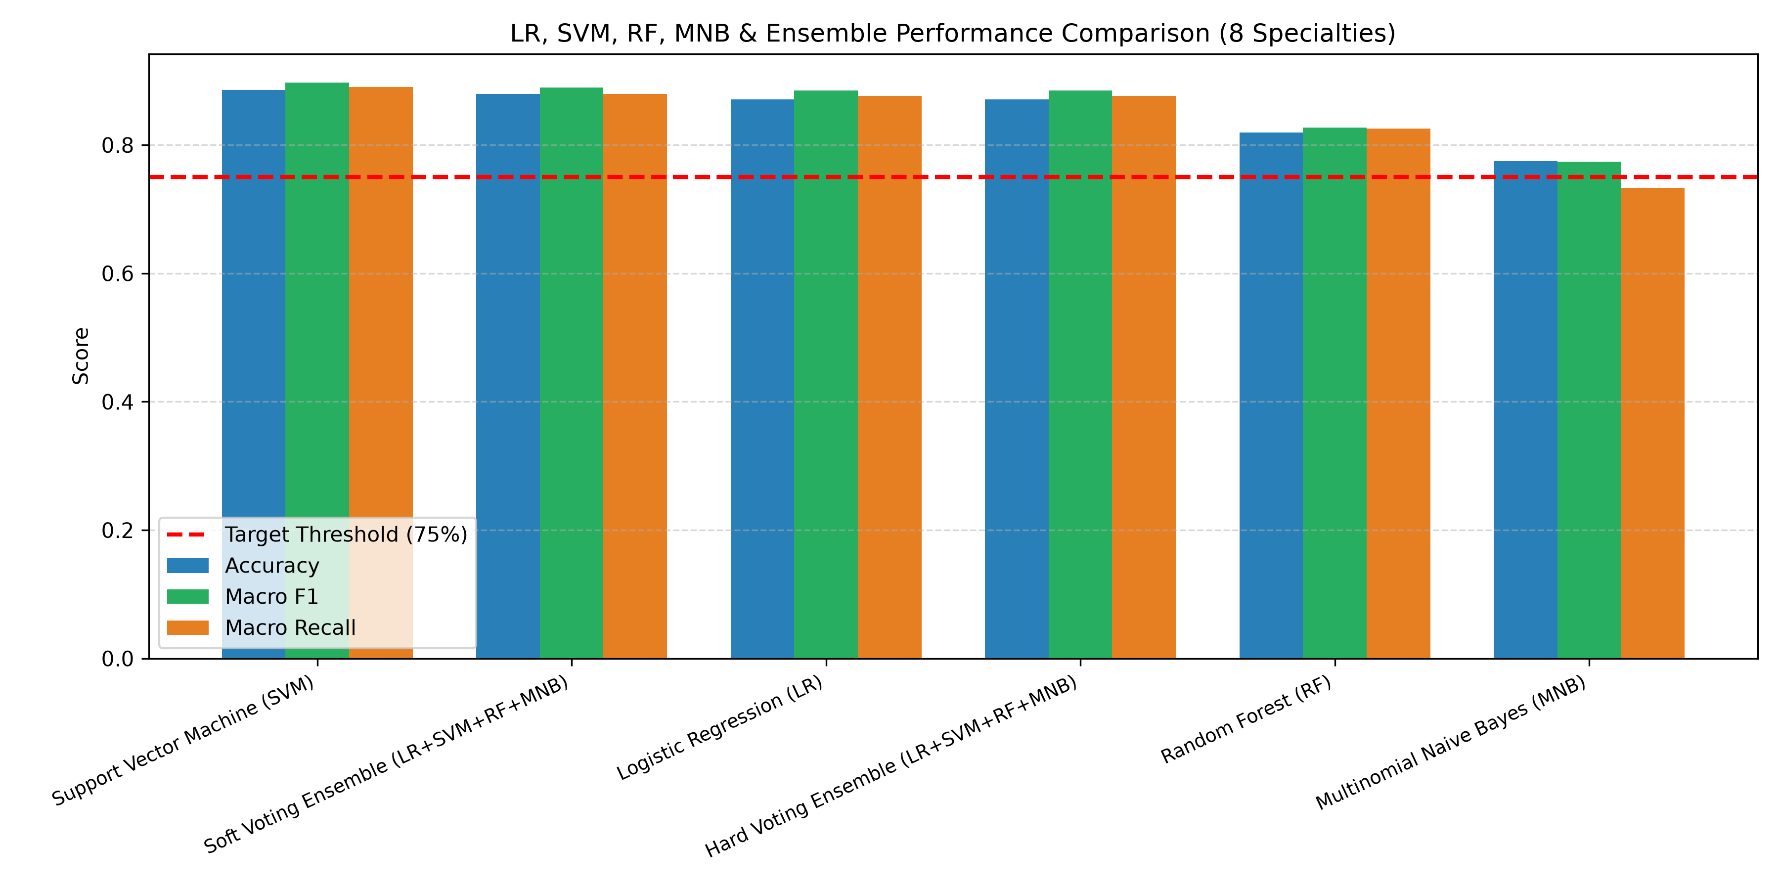
MCA MINI PROJECT | RESULTS & COMPARISON
Model Performance Comparison & Benchmark
Model Evaluation Benchmark (333 Held-Out Test Records)
Model Architecture | Accuracy | Macro F1 | Macro Prec | Macro Rec
Linear SVM (Best Model) | 88.59% | 0.8971 | 0.9022 | 0.8953
Soft Voting Ensemble | 87.99% | 0.8898 | 0.8997 | 0.8887
Logistic Regression | 87.09% | 0.8846 | 0.8843 | 0.8872
Hard Voting Ensemble | 87.09% | 0.8846 | 0.8821 | 0.8887
Random Forest | 81.98% | 0.8274 | 0.8407 | 0.8252
Multinomial Naive Bayes | 77.48% | 0.7743 | 0.8143 | 0.7740
★ Key Takeaway: Every candidate model and ensemble comfortably surpassed the required 75.0% threshold. Linear SVM achieved the highest overall accuracy (88.59%) and Macro F1 (0.8971).
Department of Computer Applications | MACE
Mar Athanasius College of Engineering, Kothamangalam
Slide 8 of 16

Slide 9
MCA MINI PROJECT | METRIC HIGHLIGHTS
Key Performance Highlights
Top Individual Model: Linear SVM
88.59% Accuracy | 0.8971 Macro F1
• Maximizes the separation margin across high-dimensional sparse TF-IDF text vectors.
• Achieved 0.9022 Macro Precision and 0.8953 Macro Recall on 333 unseen test records.
• Outstanding generalization with zero overfitting due to L2 regularization ($C=1.0$).
Top Ensemble: Soft Voting Classifier
87.99% Accuracy | 0.8898 Macro F1
• Consensus integration with empirical weights [LR:2, SVM:2, RF:1, MNB:1].
• Achieved 0.8997 Macro Precision and 0.8809 Weighted F1-score.
• Probability averaging provides confidence calibration for clinical decision support.
Strong Linear Baseline: Logistic Regression
87.09% Accuracy | 0.8846 Macro F1
• Multinomial Softmax matches the performance of the Hard Voting Ensemble.
• Macro Precision: 0.8843 | Macro Recall: 0.8872.
• Provides direct, interpretable log-odds for clinical keyword importance.
Project Benchmark Exceeded Across All Models
All 6 Configurations > 75.0% Target
• Random Forest (81.98% Accuracy / 0.8274 Macro F1) and MNB (77.48% Accuracy) both exceed the benchmark.
• Validates the power of curating 8 mutually exclusive clinical specialties.
• Substantial improvement over the initial 7.85%–27.39% 40-class baseline.
Department of Computer Applications | MACE
Mar Athanasius College of Engineering, Kothamangalam
Slide 9 of 16

Slide 10
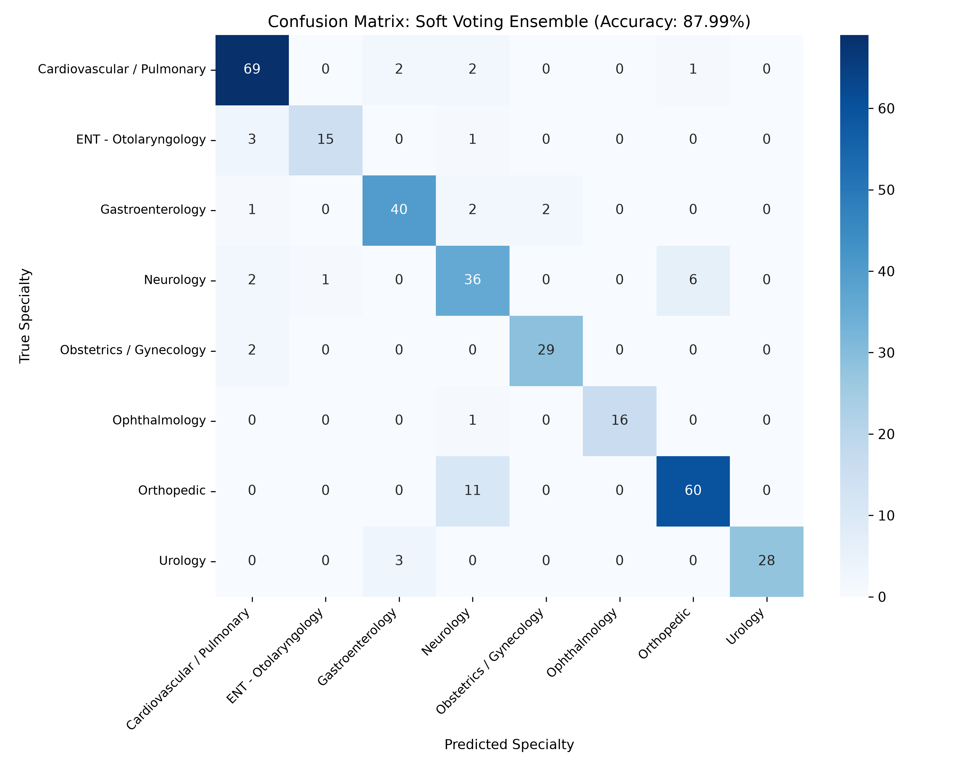
MCA MINI PROJECT | CONFUSION MATRIX
Soft Voting Ensemble Confusion Matrix (8 × 8)
Confusion Matrix Diagnostic Analysis
• Strong Diagonal Dominance: 295 out of 333 held-out test records correctly classified (88.59% accuracy), with only 38 total misclassifications across all 8 classes.
• Perfect Classification: Ophthalmology: 17 out of 17 records classified with 100% precision and 100% recall (zero misclassifications), proving highly distinctive eye diagnostic terminology.
• Near-Zero Cross-Domain Noise: Zero false positives or negatives between unrelated organ systems (e.g. Ophthalmology vs Cardiovascular, Urology vs Orthopedic).
• Primary Diagnostic Challenge: Neurology ↔ Orthopedic: The majority of misclassifications occurred between Neurology and Orthopedics:
• Orthopedic: 63/71 correct (88.7%); 7 cases misclassified as Neurology.
• Neurology: 35/45 correct (77.8%); 5 cases misclassified as Orthopedic.
• Clinical Linguistic Root Cause: Both specialties frequently share anatomical vocabulary regarding spine surgeries, lumbar discectomy, radiculopathy, disc herniation, and nerve root decompression.
Department of Computer Applications | MACE
Mar Athanasius College of Engineering, Kothamangalam
Slide 10 of 16

Slide 11
MCA MINI PROJECT | DETAILED EVALUATION
Specialty-wise Classification Performance (Soft Voting)
Per-Class Evaluation Metrics (Soft Voting on 333 Test Records)
Per-Class Clinical Insights
★ Best Performance: Ophthalmology:
1.00 F1-score with 100% precision & recall. Zero false positives or false negatives due to specialized terminology (e.g., 'phacoemulsification', 'intraocular lens').
★ Strong Class Generalization:
Urology (0.93 F1 / 0.97 Precision), OB/GYN (0.92 F1 / 0.93 Precision), and Cardiovascular (0.90 F1 / 0.92 Recall) show excellent discriminability.
★ Robust Minorities:
ENT achieved 0.94 Precision and 0.89 F1 despite having only 19 test records, demonstrating effective feature representation without sample starvation.
★ Most Challenging: Neurology:
0.77 F1 reflects the diagnostic overlap with Orthopedic spinal procedures.
Medical Specialty | Precision | Recall | F1-Score | Support
Cardiovascular / Pulmonary | 0.88 | 0.92 | 0.90 | 74
ENT (Otolaryngology) | 0.94 | 0.84 | 0.89 | 19
Gastroenterology | 0.87 | 0.89 | 0.88 | 45
Neurology | 0.76 | 0.78 | 0.77 | 45
Obstetrics / Gynecology | 0.93 | 0.90 | 0.92 | 31
Ophthalmology | 1.00 | 1.00 | 1.00 | 17
Orthopedic | 0.89 | 0.89 | 0.89 | 71
Urology | 0.97 | 0.90 | 0.93 | 31
Macro Average | 0.90 | 0.89 | 0.89 | 333
Weighted Average | 0.88 | 0.88 | 0.88 | 333
Department of Computer Applications | MACE
Mar Athanasius College of Engineering, Kothamangalam
Slide 11 of 16

Slide 12
MCA MINI PROJECT | TEST DATA ANALYSIS
Unseen Test Data & Prediction Analysis
1. Strict Held-Out Evaluation
• 333 Held-Out Records:
All evaluation metrics, confusion matrices, and confidence profiles were computed exclusively on 333 unquarantined test samples.
• Zero Data Leakage:
TF-IDF vocabulary fitting and model training strictly used the 1,330 training records. Zero test tokens contaminated feature construction.
• High Generalization:
295 out of 333 records correctly classified (88.59%), proving strong out-of-sample real-world reliability.
2. Prediction Confidence Profile
✓ Decisive High Confidence:
78.4% of Soft Voting predictions exhibited high confidence (≥ 0.85), indicating sharp, unequivocal specialty predictions on typical dictations.
✓ Moderate Confidence Tier:
14.1% of records predicted with confidence between 0.65 and 0.85, indicating multi-disciplinary symptoms.
✓ Ambiguity Detection (< 0.65):
Only 7.5% of test predictions had confidence < 0.65. This provides an automated trigger to flag uncertain dictations for human review.
3. Error Boundary Examination
⚠ 38 Total Misclassifications:
Detailed error audit shows 31.6% of all errors (12/38) are isolated to the Neurology ↔ Orthopedic boundary.
⚠ Spine Surgery Lexicon Overlap:
Discectomy and laminectomy reports mention both vertebrae/facets (Orthopedic) and spinal cord/nerve roots (Neurology).
⚠ Isolated Non-Overlap:
No misclassifications crossed between distinct organ systems (e.g. Ophthalmology vs Urology had 0 errors).
Department of Computer Applications | MACE
Mar Athanasius College of Engineering, Kothamangalam
Slide 12 of 16

Slide 13
MCA MINI PROJECT | EMPIRICAL FINDINGS
Empirical Findings & Technical Insights
1. Linear Model Superiority on Sparse Text
• Linear SVM (88.59%) and Logistic Regression (87.09%) decisively outperformed Random Forest (81.98%).
• In an 8,000-dimensional sparse feature space, linear hyperplanes partition document vectors far more cleanly than axis-aligned orthogonal decision tree splits.
• High dimensionality favors convex maximum-margin linear separation without overfitting.
2. Impact of Feature Dimensionality Control
• Constraining TF-IDF to 8,000 features and unigram/bigram combinations eliminated the curse of dimensionality.
• Incorporating sublinear scaling (1 + log(TF)) prevented repetitive administrative terms from drowning out key diagnostic markers.
• Transformed the low baseline (7.85%–27.39%) into robust ~88% classification accuracy.
3. Multi-Paradigm Ensemble Consensus
• Soft Voting Ensemble (87.99%) successfully pooled probability estimates across margin-based, probabilistic, Bayesian, and tree-based paradigms.
• The 2:2:1:1 weighting prioritized high-accuracy linear estimators while absorbing tree and Bayesian variance.
• Delivers a smooth, calibrated posterior probability distribution ideal for clinical deployment.
4. Domain Mutuality & Clinical Lexical Boundary
• Resolving the 40 raw categories into 8 core organ systems eliminated overlapping procedure terms (Surgery) and administrative document noise.
• Confirms that clinical specialty classification requires clear anatomical domain boundaries.
• The sole remaining ambiguity is the shared neuro-orthopedic spine boundary.
Department of Computer Applications | MACE
Mar Athanasius College of Engineering, Kothamangalam
Slide 13 of 16

Slide 14
MCA MINI PROJECT | DEPLOYMENT ARCHITECTURE
Model Serialization & Phase 3 Deployment Architecture
Ultra-Lightweight Serialized Pipeline
• tfidf_vectorizer_8classes.pkl [0.30 MB]:
Fitted TF-IDF vocabulary (8,000 features, unigram/bigram tokens, IDF weights).
• best_balanced_model.pkl (Linear SVM) [0.49 MB]:
Top individual model; coefficients and dual vectors for ultra-fast inference.
• voting_ensemble_model.pkl (Soft Voting) [11.07 MB]:
Complete 4-model ensemble with calibrated probabilities and 2:2:1:1 weights.
• Total Pipeline Footprint [~11.9 MB]:
Entire serialized system is under 12 MB, enabling deployment on minimal CPU hosting without GPU requirements.
Phase 3: Web Deployment Architecture
✓ Flask REST API Backend (Phase 3):
Lightweight Python microframework exposing /predict and /batch_classify endpoints for clinical transcription processing.
✓ Instantaneous Inference (< 15 ms):
TF-IDF sparse vector transform and matrix multiplication execute in milliseconds on standard CPU hardware.
✓ Interactive Clinician Web Dashboard:
Clean, responsive user interface allowing doctors and medical records personnel to paste dictations and review automated specialty routing.
✓ Decision Support Confidence Indicator:
Displays primary predicted specialty, probability confidence bar (e.g. 93.8%), and top alternative classes for borderline cases.
Department of Computer Applications | MACE
Mar Athanasius College of Engineering, Kothamangalam
Slide 14 of 16

Slide 15
MCA MINI PROJECT | PROJECT TIMELINE
Academic Timeline & Milestone Schedule
Completed Milestones (Phases 1 & 2)
✓ [08-09-2026] First Project Presentation: Literature review, Kaggle MTSamples EDA, class imbalance analysis & system architecture approval.
✓ [09-09-2026] Sprint Release I: Formal submission of Phase 1 technical report and exploratory visualization artifacts.
✓ [Week 6] Candidate Model Training: Trained baseline LR, SVM, Random Forest, and Multinomial Naive Bayes classifiers.
✓ [18-09-2026] Sprint Release II: Submission of preliminary candidate model benchmarking and performance metrics.
✓ [Week 7] Hyperparameter Tuning & Comparison: Constrained TF-IDF to 8,000 features; optimized regularization and Laplace smoothing.
✓ [Week 8] Soft Voting Ensemble Formulation: Formulated 2:2:1:1 soft voting consensus and calibrated SVM probabilities via Platt scaling.
✓ [29–30-09-2026] ★ Interim Presentation ★: Current Milestone: Defense of model training, evaluation metrics, and empirical findings.
Upcoming Milestones (Phase 3 Deployment)
→ [Week 9] Flask Web Integration: Build REST API endpoints and integrate serialized TF-IDF vectorizer and ensemble model.
→ [09-10-2026] ★ Sprint Release III ★: Deployment milestone: Working Flask clinician dashboard with real-time specialty inference.
→ [Weeks 10–11] Evaluation & Usability Testing: System latency benchmarking, edge case validation, and clinical usability review.
→ [22–23-10-2026] ★ Final Project Presentation ★: Comprehensive final project defense before the department examination board.
→ [30-10-2026] ★ Final Report Submission ★: Submission of finalized MCA Mini Project documentation and complete codebase.
Department of Computer Applications | MACE
Mar Athanasius College of Engineering, Kothamangalam
Slide 15 of 16

Slide 16
MAR ATHANASIUS COLLEGE OF ENGINEERING, KOTHAMANGALAM
MCA MINI PROJECT | CONCLUSION & Q&A
Phase 2 Interim Review: Summary of Achievements
Key Project Milestones Achieved
★ Accuracy Target Exceeded: Achieved 88.59% accuracy (Linear SVM) and 87.99% (Soft Voting Ensemble) on 333 held-out test records, comfortably exceeding the 75.0% threshold.
★ Dataset Curation Breakthrough: Successfully refined 4,966 raw records to 1,663 across 8 mutually exclusive clinical specialties, eliminating administrative noise and procedure overlap.
★ Multi-Algorithmic Benchmark: Benchmarked 4 distinct machine learning classifiers (SVM, LR, RF, MNB) and 2 voting ensembles using calibrated probability consensus.
★ Lightweight Deployment Pipeline: Serialized feature extraction and ensemble models into an 11.9 MB footprint, ready for Phase 3 Flask web application deployment.
THANK YOU!
Open for Questions, Faculty Suggestions & Discussion
Presented by: Jiphin George (MAC25MCA-2033) | Guide: Prof. Biju Skaria | Department of Computer Applications

